Slide 1

AUTOMATIC SPECTRUM SHARING TECHNIQUE USING COGNITIVE RADIO NETWORK FOR EFFICIENT MOBILE COMMUNICATION
Department of Electronics and Communication Engineering
Batch Number : NSNCET/17-18/EC-PRJ/16
Project Members : N.PRIYA, ECE (921814106026)
K.SANGEETHA, ECE (921814106037)
P.SANGEETHA, ECE (921814106038)
Project Supervisor : Mrs.M.Parvathi. AP/ECE
Industrial Supervisor: Mr. O.Anbalagan. AGM,BSNL,Trichy
1
NSNCET/17-18/EC-PRJ/16 University Viva/18.04.2018

Slide 2
ABSTRACT
CRN shares the radio resources with a licensed network
Increases the spectral and energy efficiency
Improve the utilization of the radio spectrum

Slide 3
INTRODUCTION
Wireless communication provide the long range of communication
Communication have many methods to improve the energy efficiency
Cognitive Radio Network used to share the spectrum

Slide 4
EXISTING SYSTEM
Energy efficiency problem
Only one secondary user can participate in one time slot
Price based water filling algorithm is used

Slide 5
LITERATURE SURVEY
S.NO | TITLE | AUTHOR NAME | YEAR | DESCRIPTION
1. | Interference Efficiency: A New Metric to Analyze the Performance of Cognitive Radio Networks | Mohammad Robat Mili,Leila Musavian | 2017 | The spectrum sharing scenarios are used to share the primary and secondary spectrum.
2. | Route Selection for Multi hop Cognitive Radio Network using Reinforcement Learning. | Aqeel Raza syed, Kok-Lim Alivin yau,Junaid Qadir, Hafizal Mohamad, Nordin Ramil, Sye Loong Keog. | 2016 | Multi-hop CR network is to select a route with high quality of service and lesser number of route breakages.

Slide 6
LITERATURE SURVEY(Contd…)
3. | Spectrum map aided multi channel multi hop routing in distributed CRN | Saptarshi Debroy, Mainak chatterjee | 2014 | Analyze and compute the probability of network connectivity by finding the minimum spanning tree of the graph formed by the over-lapping domains
4. | Channel Adaptive Spectrum Detection and Sensing Strategy for Cognitive Radio Ad-hoc Network | Yuan Lu, Alexandara Duel Hallen | 2014 | The threshold is adapted to the instantaneous PU to SU channel state information under the prescribed collision probability constraint.

Slide 7
LITERATURE SURVEY(Contd…)
5. | Spectrum Map Empowered Opportunistic Routing for Cognitive Radio Ad hoc Networks | Shih-chun lin, Kwang-cheng chan | 2013 | For regular and large-scale with wireless fading Channels, employing a cooperative networking scheme to Enable multipath transmissions.
6. | Channel Aware Spectrum Sensing and Access for Mobile Cognitive Radio Ad-hoc Network | Yuan Lu, Alexandara Duel Hallen | 2013 | Sensing include high CRN throughput and node mobility. Analytical and numerical result mention the proposed sensing.

Slide 8
LITERATURE SURVEY(Contd…)
7. | Network Selection in Cognitive Heterogeneous Networks Using Stochastic Learning | Li-Chuan Tseng,Feng-Tsun Chien,Daqiang Zhang,Ronald Y.Chang. | 2013 | The network selection problem handled using game theory .It provide fairness performances in various network.
8. | Distributed Spectrum Sensing in Cognitive Radio Networks with Fairness Consideration: Efficiency of Correlated Equilibrium | Sabita maharjan,Yan Zhang,chau Yuen,stein Gjessing. | 2012 | This paper access the spectrum and improve the channel adaption and power allocation.It uses novel approach.

Slide 9
LITERATURE SURVEY(Contd…)
9. | Pricing-based Spectrum Access Control in Cognitive Radio Network with Random Access | Lei Yang,Hongseok Kim,Junshan Zhang,Mung chiang and Chee wei tan. | 2011 | The impact of pricing based random access used for dynamic spectrum sharing .It uses two models one with a monopoly primary user market and other with a multiple PU market.
10. | Adaptive Spectrum Sensing and Learning in Cognitive Radio Network | Abbas Taherpour , Saeed Gazor and Abolfazel Taherpour. | 2010 | In this paper the wideband spectrum sensing scheme used to share the spectrum. The address learning process uses two state Markov chain method.

Slide 10
PROPOSED SYSTEM
Overcome energy efficiency problem
Spectrum aggregation-based cooperative routing protocol
Primary - reduce power consumption and throughput maximization
Secondary - reduce the end to end delay

Slide 11
METHODOLOGY
CRN
USER 1
RF MODULE
ARDUINO MICRO CONTROLLER
SPECTRUM 1
RECEIVER 1
RECEIVER 2
USER 2
USER 3
SPECTRUM 2
RECIEVER 3

Slide 12
BLOCK DIAGRAM
MODE INDICATOR
ARDUINO MICROCON-TROLLER
LCD DISPLAY
RF MODULE 1
PRIMARY USER
MODE ACTIVATOR
RF MODULE 2
SECONDARY USER

Slide 13
OPERATION
At the normal mode the primary and secondary user are connected to their respective spectrum
At CRN mode the call is connected automatically to the free spectrum,when primary spectrum is overloaded

Slide 14
MODE ACTIVATOR
Switch is used as a mode activator
Used to connect the normal or CRN mode
When switch is OFF Normal mode is enabled
When switch is ON CRN mode is enabled

Slide 15

LED
To indicate the mode
Red LED-Normal Mode
Green LED-CRN Mode

Slide 16
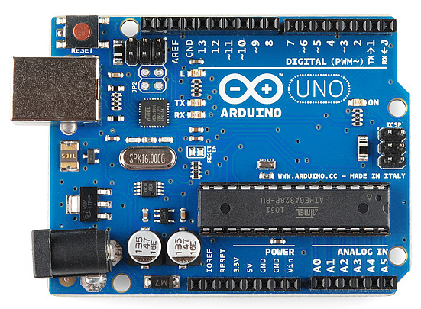
ARDUINO MICROCONTROLLER
Arduino consist of both a physical programmable circuit board and a piece of software that runs on our computer
ATmega328 microcontroller is used.

Slide 17
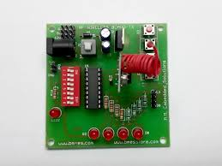
RF MODULE
It operate over a certain distance and transfer a certain amount of information within a data rate
Operating voltage range 3V to 12V
To transmit and receive the input signal

Slide 18
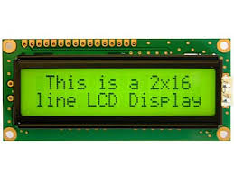
LCD
Flat panel display
Electronically modulated optical device
Uses the light modulating properties of liquid crystal
Display the output

Slide 19
SPECTRUM MANAGEMENT FRAMEWORK
QoS awareness
Seamless communication
Interference avoidance

Slide 20
SPECTRUM MANAGEMENT PROCESS
Spectrum sensing
Spectrum decision
Spectrum sharing
Spectrum mobility

Slide 21
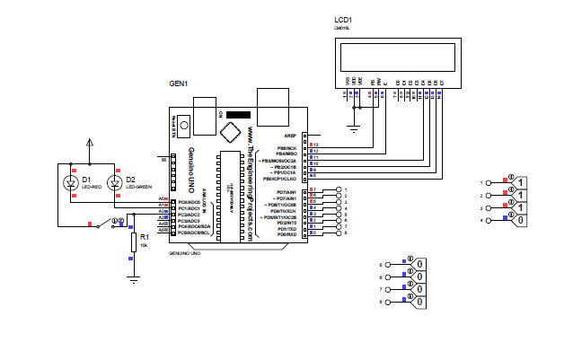
CIRCUIT DIAGRAM

Slide 22
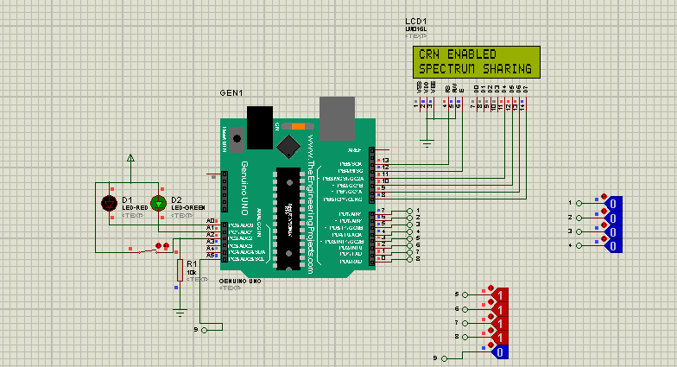
SIMULATION RESULT PROTEOUS 17.2

Slide 23
ADVANTAGES
Share spectrum automatically
Avoid interference
Increase spectrum efficiency

Slide 24
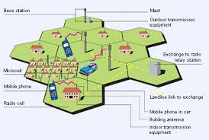
APPLICATIONS
Mobile and Wireless communication

Slide 25
PROJECT OUTCOME
At Normal Mode, the primary and secondary users calls are connected using their respective spectrum
When spectrum is overloaded, the Buzzer will be ON and then CRN mode is activated
At CRN Mode, When primary spectrum is overloaded the call is automatically connected to another free spectrum
NSNCET/17-18/EC-PRJ/16 University Viva/18.04.2018

Slide 26




Slide 27
CONCLUSION
Cognitive radio is a wireless communication technology that enhance utilization of the spectral resource
Primary and secondary users coexist in the same frequency spectrum
A secondary node acts as a relay for the primary traffic

Slide 28
REFERENCES
[1] Mohammad Robot Mile and Leila Musavin, “Interference Efficiency :A New metric to Analyze the Performance of CRN”,IEEE access,VOL 16.no.4 APRIL 2017
[2]Aqeel Raza syed, Kok-Lim Alivin yau,Junaid Qadir, Hafizal Mohamad, Nordin Ramil, Sye Loong Keog, “Selection for Multi hop Cognitive Radio Network using Reinforcement Learning”IEEE Access 2016.
[3]Saptarshi Debroy, Mainak Chatterjee “ Spectrum Map Aided Multi Channel Multi hop Routing in Distributed CRN” IEEE International Symposium on 2014
[4]Yuan Lu, Alexandara Duel Hallen “Channel Adaptive Spectrum Detection and Sensing Strategy for Cognitive Radio Ad-hoc Network” supported by the NSF grant CNS-1018447

Slide 29
REFERENCES(Contd..,)
[5]Shih-chun lin, Kwang-cheng chan “Spectrum Map Empowered OpportunisticRouting for CR Ad hoc Networks” IEEE Transaction on Vehicular technology on 2013
[6]Yuan Lu, Alexandara Duel Hallen “Channel Aware Spectrum Sensing and Access for Mobile Cognitive Radio Ad-hoc network” IEEE Consumer transaction on consumer communication and networking on 2013
[7]Li-Chuan Tseng,Feng-Tsun Chien,Daqiang Zhang,Ronald Y.Chang “Network Selection in Cognitive Heterogeneous Networks using Stochastic learning” on 2013
[8]Sabita maharjan,Yan Zhang,chau Yuen,stein Gjessing “Distributed Spectrum Sensing in CRN with fairness consideration:Efficiency of correlated equilibrium.” on 2012

Slide 30
REFERENCES(Contd..,)
[9]Lei Yang,Hongseok Kim,Junshan Zhang,Mung chiang and Chee wei tan “ Pricing-based Spectrum Access Control in CRN With Random Access” on 2011
[10]Abbas Taherpour ,Saeed Gazor and Abolfazel Taherpour. “Adaptive Spectrum Sensing and Learning in CRN.” on 2010
[11]Sudharman K.Jayaweera and Tianming Li “Dynamic Spectrum Leasing in CRN via Primary-secondary user Power ControlGames”on june 2018.
[12]Azadeh Sheikholeslami, Majid Ghaderi, Hossein Pishro-Nik “Energy-Efficient Secrecy in Wireless NetworksBased on Random Jamming” on 2012

Slide 31
THANK YOU

